Slide 1


A Procedure for Conceptualizing and Implementing SPADE Agents
Henning Gösling¹, Dennis Maecker¹, Tom Pieper¹, Timon Sachweh², and Christoph Heinbach¹
¹ German Research Center for Artificial Intelligence, Osnabrück, Germany
² TU Dortmund University, Germany

Slide 2
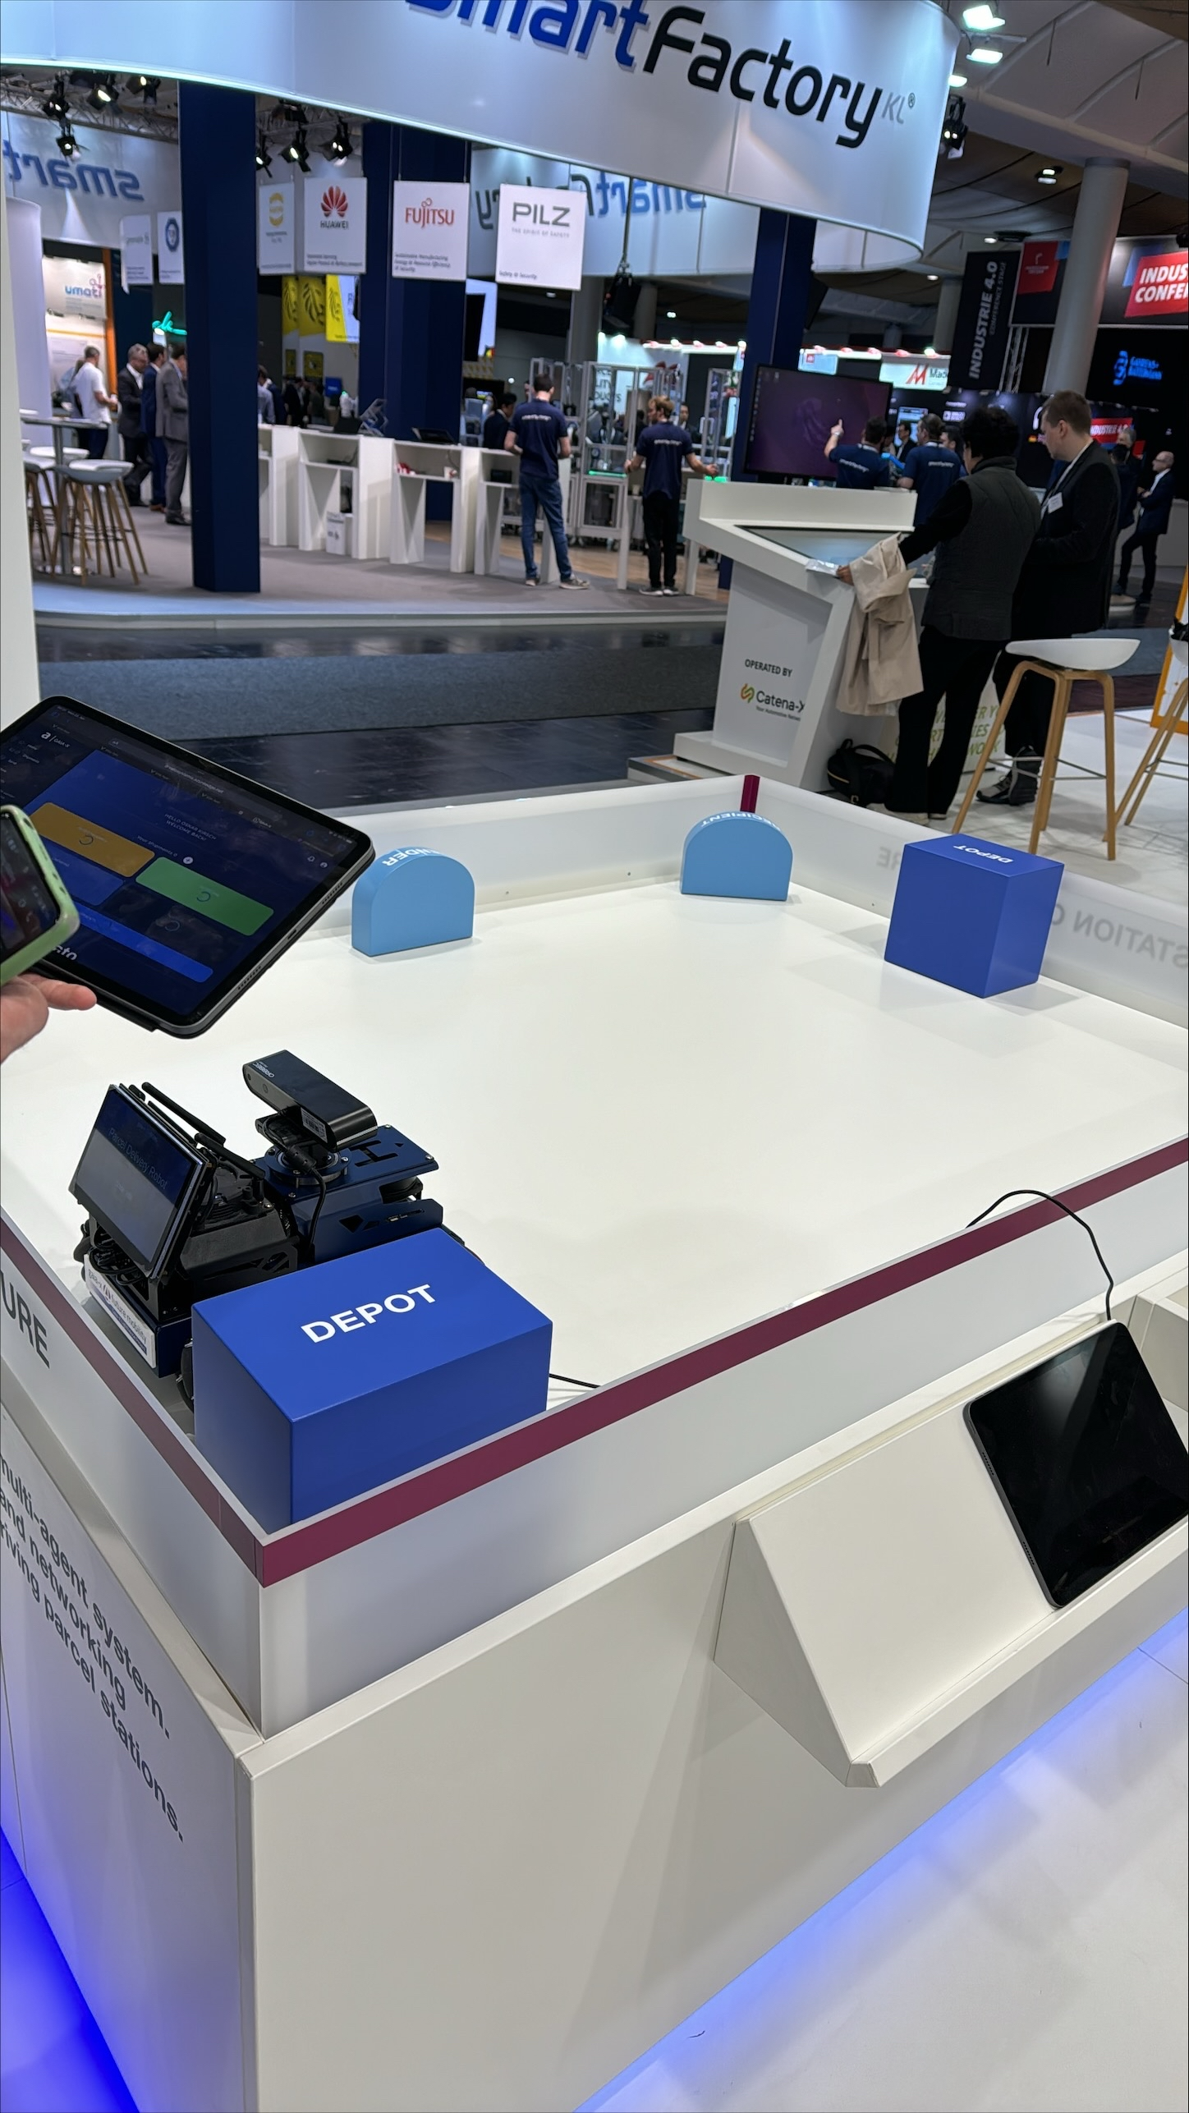
Project Gaia-X 4 ROMS
In the research project Gaia-X 4 ROMS, we automate the booking processes of transport resources involved in parcel transports:
in the pick-up of the parcel,
its main-haul transport between depots,
and its delivery.
The involved actors are physically distributed, embedded in their environment, owned by different companies, and work asynchronously
Software agents were selected as a technology that naturally fits to the use case
Gaia-X technology is used for horizontal, secure and trusted data exchange, mainly between software agents and humans/transport resources
A demonstrator for our multi-agent system was shown at Hanover Fair 2024

Slide 3
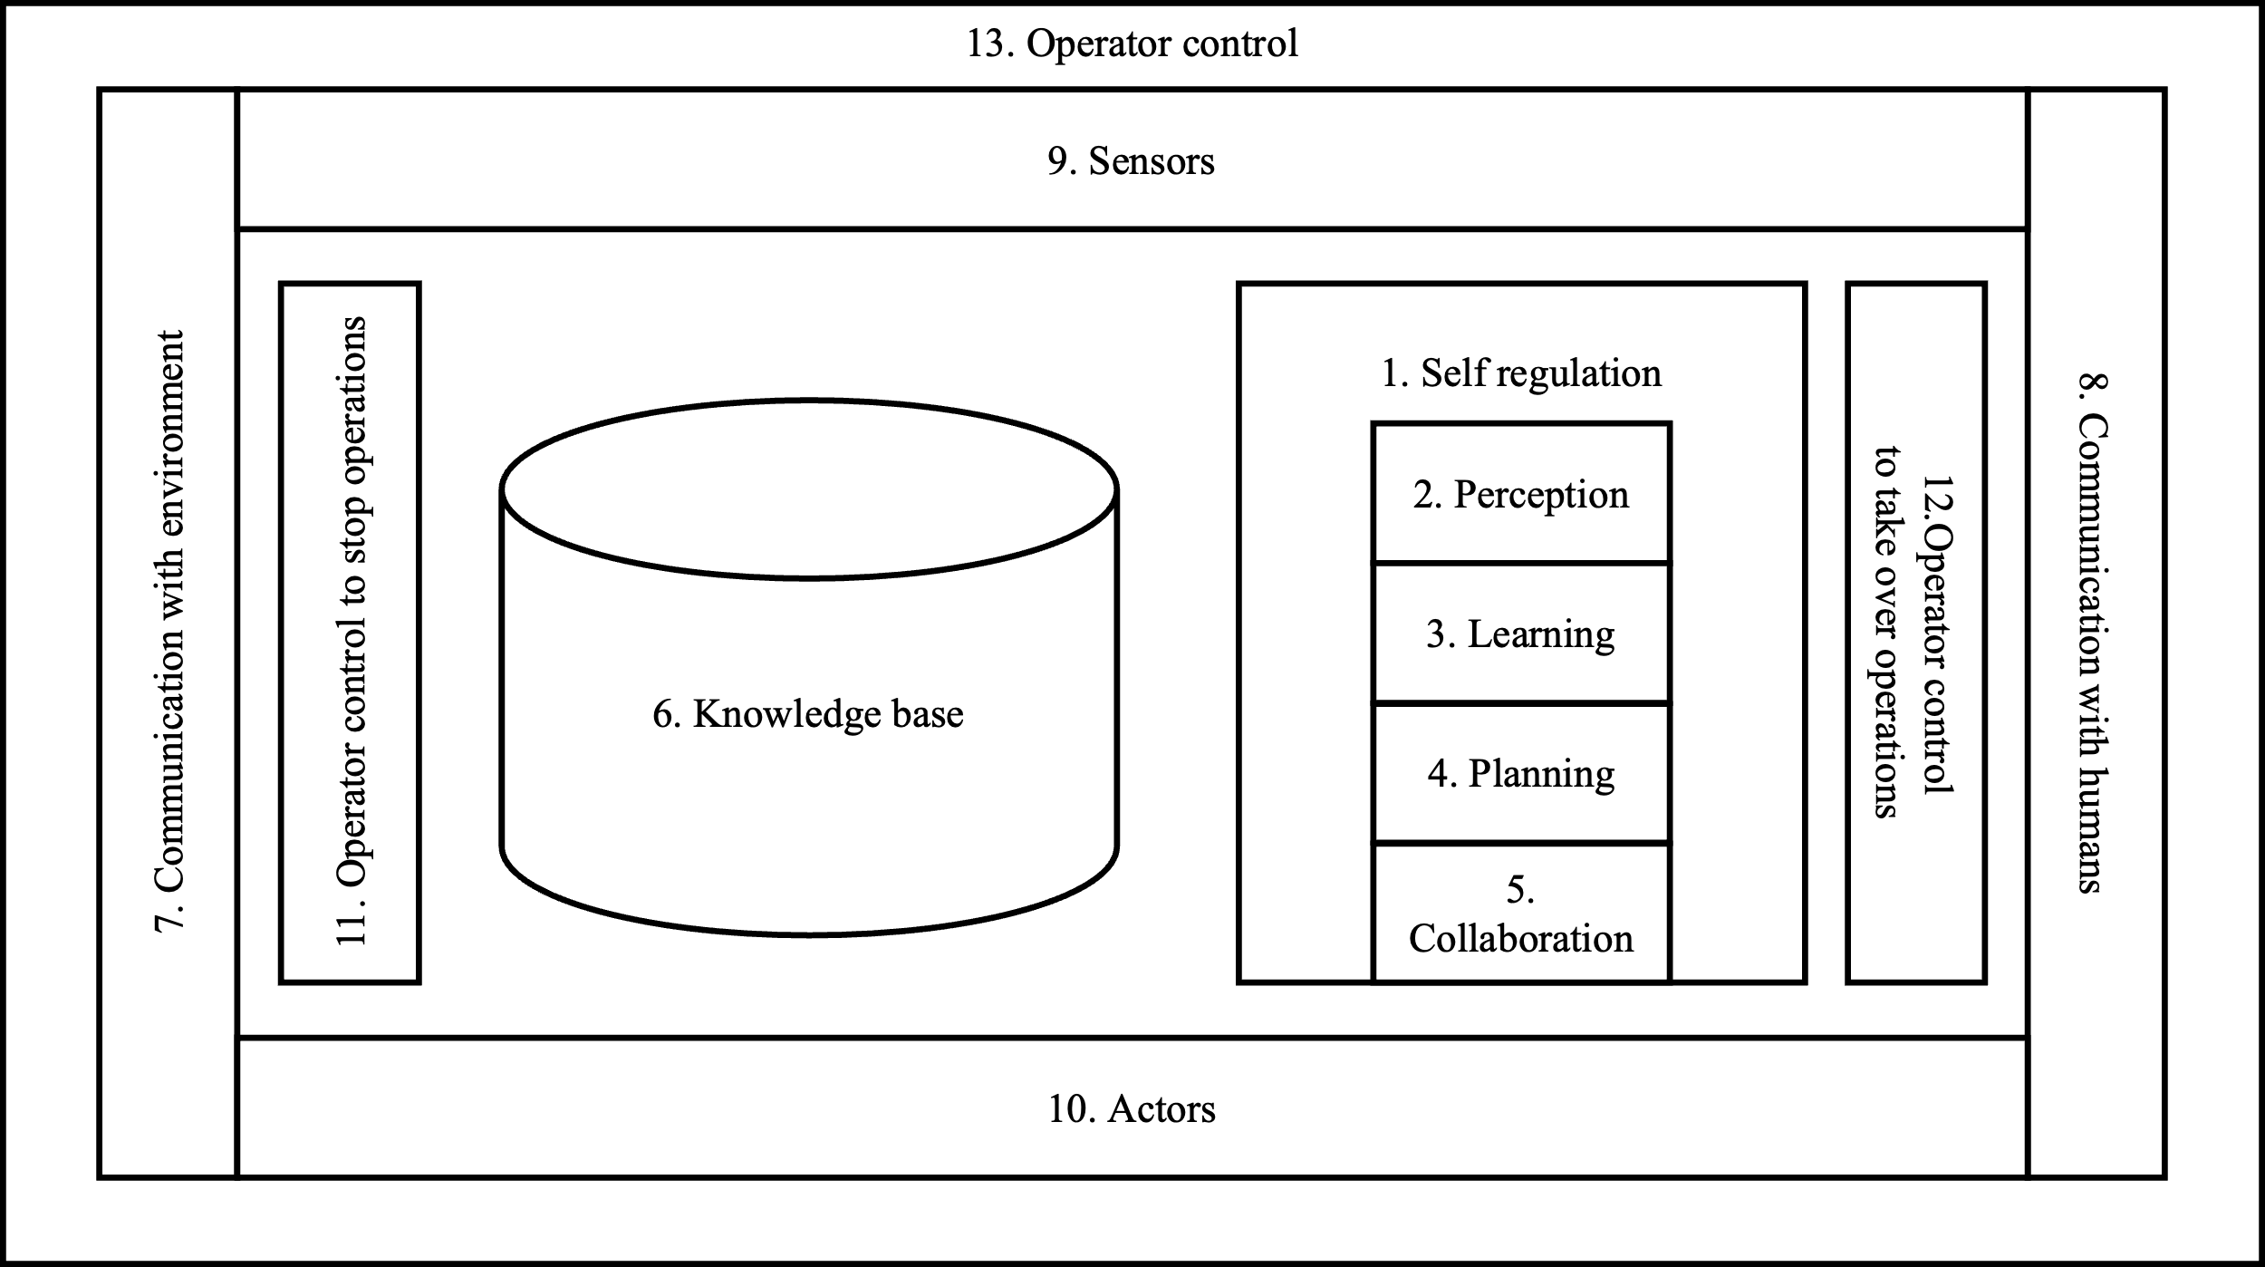
Procedure of Conceptualizing and Implementing Software Agents with SPADE
Defining the Types of Software Agents
Specifying the Components of each Software Agent using Wahlster (2017)
Conceptualizing each Component of a Software Agent
Implementing the Software Agents with Spade
Reference architecture for autonomous systems adapted from Wahlster (2017)

Slide 4
1. Defining the Types of Software Agents
Excerpt of booking management table
In the first step, several interviews were conducted between an expert in the field of MAS and an expert in the field of transport logistics.
From the insights of these interviews, the main roles in our parcel transport use case were defined:
a booking management for the interaction with customers,
parcel delivery robots for the first-mile transport,
so-called bordero management for the creation of parcel lists for scheduled long-haul transports between depots,
trailers for the long-haul transport,
parcel delivery robots for the last-mile transport,
depot management for the assignment of ramps to robots and trailers,
depots for the cross-docking between first-mile, long-haul, and last-mile transports,
and workshops for the maintenance of the transport resources.
Nr. | Responsibility | Description | Basic function vs. add-on | Interaction with operators, robots, or remote software | Interaction with other software agents
1 | Collection of shipping orders | The booking agent receives the transport orders from the booking platform, which are divided into three partial orders (first-mile, long-haul and last mile) and contain information on depots, time restrictions and release times. | Basic function | Booking platform
2 | Validation of shipping orders | The booking agent uses a verification mechanism to check the transport orders for type of goods, destination, weight, plausibility, and speed (same day/hour, overnight, etc.). If necessary, a query is made for dangerous goods, prohibited substances, live animals or organisms. Transports are only approved for the transportation of goods within Germany. | Add-on
4 | Determination of release times for partial orders | The booking agent determines the release times for the partial orders. | Add-on
5 | Distribution of the individual partial orders | The booking agent distributes the partial orders via a multi-agent-specific coordination mechanism as soon as the release times have been reached. | Basic function |  | PDR agents Bordero agents Trailer agents Depot agents
… | … | … | … | … | …

Slide 5
2. Specifying the Components of each Software Agent using Wahlster (2017)
In the second step, we defined the architecture for each type of software agent based on Wahlster (2017)
When specifying the architecture, we tried to match the standard components of a software agent with the responsibilities of each software agent defined in the first step of the procedure.
Architectural designs for booking agent and PDR agent (excerpt)
Software agent | Architectural design
Booking agent | To allow transport order operators (users) to automate the process of placing and modifying bookings for parcel deliveries from/to customers (aim) when parcel delivery robots are used for first- and last-mile transports in urban areas and telematics-enabled trailers are used in main-haul transports between depots (context), a booking agent should be available that consists of the following functions (mechanisms) in line with Wahlster (2017) (rationale): a self-regulation mechanism (see 1. in Wahlster, 2017) to orchestrate the different functions of a booking agent and their interactions with a booking agent's knowledge base (6.) a collaboration mechanism (5.) with PDR agents to assign transport orders to PDR agents with bordero agents to assign freight orders to bordero agents a communication mechanism (7.) to publish booking specifications to subscribe to messages of bordero agents, trailer agents, PDR agents, and depot agents to collect the current state of the parcel deliveries a user interface (8./13.) to start and stop a booking agent to create bookings for parcel deliveries to show the current state of parcel deliveries to change booking specifications and cancel bookings
PDR agent | To allow transport order operators (users) to automate the process of assigning transport orders to parcel delivery robots (aim) when these mobile robots are used for first- and last-mile transports of parcels in urban areas, each PDR should be represented by a corresponding agent with the following functions (mechanisms) in line with Wahlster (2017) (rationale): a self-regulation mechanism (1.) to orchestrate the different functions of a PDR agent and their interactions with a PDR agent's knowledge base (6.) a planning mechanism (4.) minimizing the marginal costs when adding a transport order or a battery charging order to the internal tour list …
… | …

Slide 6
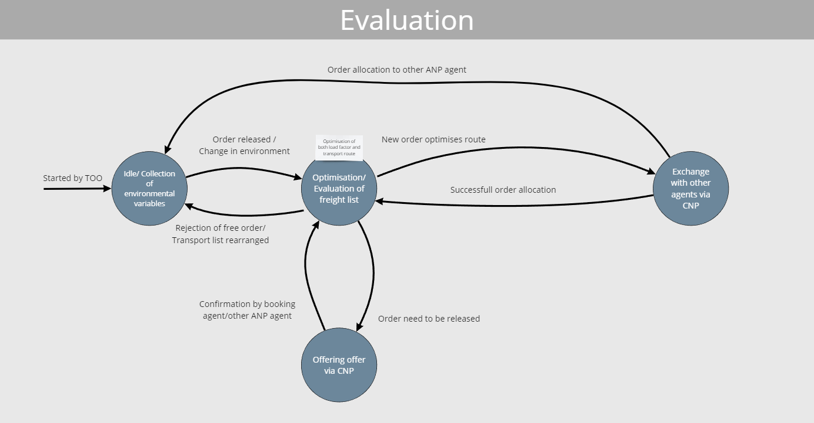
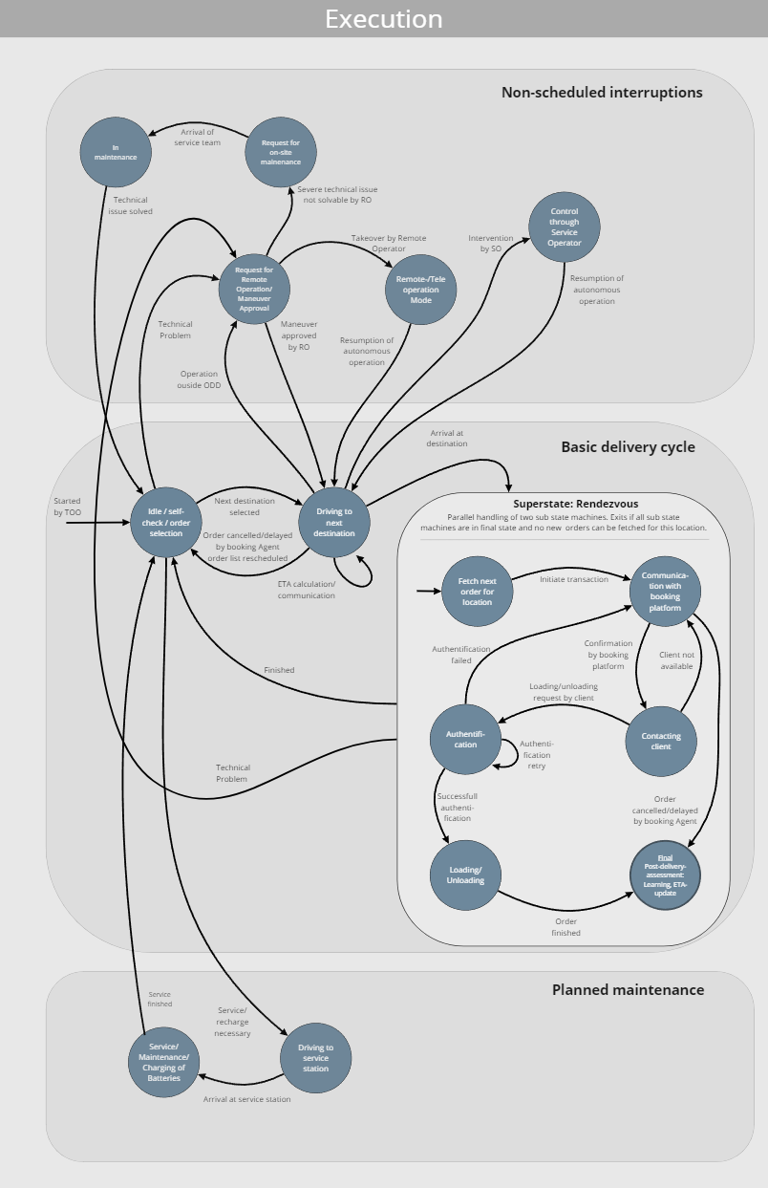
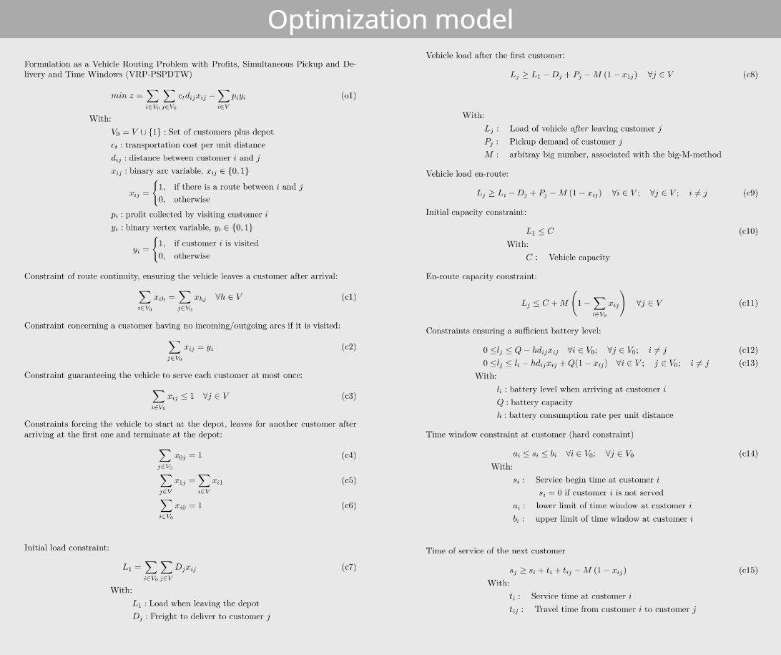
3. Conceptualizing each Component of a Software Agent
Models for the components of the PDR agent (indicated)
PDR agent component | Concept model type | Model (indicated by screenshots from Miro board)
Self regulation (see 1. in Wahlster, 2017) | State machines for evaluation routine and execution routine
Planning (4.) | Mathematical model of the single-vehicle routing problem with pickups and deliveries and time windows
… | … | …
In the third step of our procedure, we defined a separate concept for each component of our software agents:
The self-regulation mechanisms were modeled with finite-state machines
The knowledge base was modeled with a UML class diagram
The communication and interaction with other software agents, remote software services, user interfaces of operators, and actors/sensors were modeled with a UML component diagram
The planning mechanism for optimizing a software agent’s schedule was modeled with an optimization model
The collaboration mechanism for assigning tasks was modeled based on the Contract-Net-Protocol
For the self-regulation, at least two routines, an evaluation and an execution routine, were defined per agent in accordance with the MAPE-K architecture
For the optimization model, we looked for standard problems in the Operations Research literature that could be used as the starting point for the mathematical formulation

Slide 7
4. Implementing the Software Agents with SPADE
Spade classes and Python libraries to develop the different agent components
The Spade can be used to build most of the necessary components of a software agent or at least allows the integration of various Python libraries
For the collaboration between software agents, there were neither Spade classes nor Python libraries to be used out of the box
We decided to develop a SPADE extension during our research project that allows for different types of order assignments (with or without user interaction) among software agents using CNP-based auctions
Software agent component | Python | Spade | Python libary | Individual solution
Self-regulation (see 1.in Wahlster, 2017) |  | x
Learning (3.) |  |  | x (PyTorch, NumPy, gymnasium for reinforcement-learning)
Planning (4.) |  |  | x (Pyomo for classical optimization & PyTorch, NumPy, gymnasium for reinforcement-learning based optimization)
Collaboration (5.) |  |  |  | x
Knowledge base (6.) | x |  | x
Communication with environment (7.) |  | x (XMPP)
UI (8./13.) |  | x (for agent status) | x (aiohttp, jinja2, plotly)
Sensor and actor integration (9./10.) |  |  | x (Flask-SocketIO)

